Slide 1
Learning from DITA-CCMS Tool - Heretto
Pranali Shivale

Slide 2
Introduction to Heretto
What is Heretto?
Heretto is a Component Content Management System (CCMS) designed for structured content using DITA.
Content Creation & Management – Enables efficient authoring, organizing, and reusing content.

Slide 3
Why use Heretto?
Single-source content management
Multichannel publishing
Workflow and collaboration tools

Slide 4
Understanding DITA-CCMS
What is a CCMS?
A Component Content Management System (CCMS) is a specialized system for managing structured content at a granular level. Unlike traditional CMS, which handles whole documents.
A system that manages modular, reusable content
Facilitates version control, localization, and publishing
For understanding what is DITA refer to https://drive.google.com/file/d/1ymaqjJkr42KE4iQfJq8SrcYLY6rqw1iq/view?usp=drive_link

Slide 5
CCMS VS Traditional CMS
Feature | CCMS | CMS
Content Structure | XML-based, modular | Unstructured or semi-structured
Reusability | High | Low
Version Control | Strong version tracking | Limited
Multichannel Output | Web, PDF, mobile, chatbots | Mostly web
Collaboration /Role based Access | Workflow-based | Basic collaboration

Slide 6
Key Features of Heretto
Structured Authoring with DITA
Content Reusability & Version Control
Real-time Collaboration
Multichannel Publishing (Web, PDF, Chatbots, etc.)
Content Localization & Translation Management
API Integrations & Customization

Slide 7
Benefits of Using Heretto
Increases Efficiency – Write once, reuse multiple times
Improves Collaboration – Teams work together seamlessly
Enhances Content Accuracy – Version control prevents errors
Supports Publishing – Deliver content to multiple platforms

Slide 8
Heretto Workflow
Content Creation: Author content using DITA
Content Management: Store, version, and reuse content
Review & Collaboration: Assign workflows, approve, and edit
Publishing: Deliver content across different platforms

Slide 9
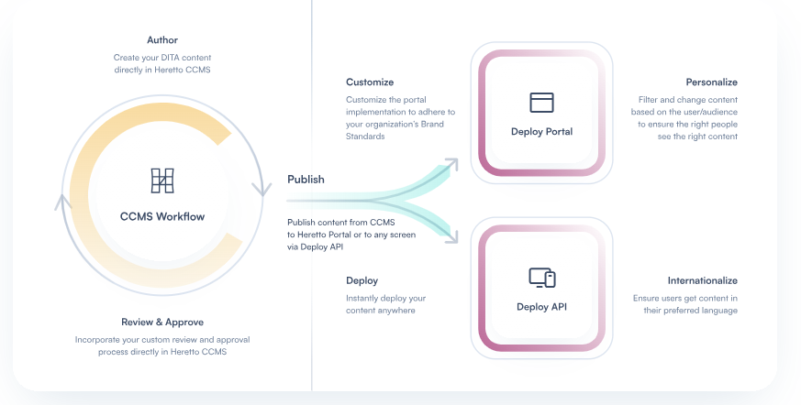
Work Flow of Heretto
.

Slide 10
CCMS Platforms Other than Heretto
Paligo – Cloud-based CCMS with structured authoring and version control.
IXIASOFT CCMS – Scalable DITA-based solution with advanced workflow management.
Adobe Experience Manager Guides – AI-powered, enterprise-grade CCMS with seamless integration.
Vasont CCMS – XML-based platform with workflow automation and multi-channel publishing.
SDL Tridion Docs – AI-driven structured content management for global enterprises.

Slide 11
Why conga used hereto as CCMS?
Conga documents were initially stored in Confluence, which also functions as a CMS. However, they were migrated to Heretto due to its superior content management and storage capabilities.

Slide 12
Use Cases of Heretto
How Conga is Used in Heretto?
Content Mapping – Conga analyzes and maps existing content to DITA structures for better organization.
Content Transformation – Converts unstructured content into structured DITA topics and components.
Validation & Quality Check – Ensures content follows DITA standards and checks for errors.
Review & Approval – Content is reviewed, refined, and approved through workflow management.
Publishing – The validated content is published across multiple formats (PDFs, websites, apps, etc.).

Slide 13
Challenges & Considerations
Learning Curve – Requires understanding of DITA
Implementation Costs – Cloud-based subscription
Integration Needs – API support for other tools

Slide 14
Conclusion
Heretto is a powerful DITA-CCMS tool for structured content management
Ideal for organizations needing scalable, reusable content solutions
Enhances efficiency, collaboration, and publishing capabilities

Slide 15
References
https://help.heretto.com/en
https://conga-staging.portal.heretto.com/en

